Slide 1



Flip Robo Technologies
Customer Retention
Project Presentation
Presented by
Naveen Kumar Ranganathan

Slide 2

Introduction
Globally customers are getting attracted towards online retailing; this is because e-stores usually offer them a variety of services and products according to their preferences. Convenience, round the clock availability, flexible pricing, discounts as well as free door step delivery are some of the major benefits of shopping online. Presently, more number of online retailers are beginning to experience increase in demand for products and service.
Indian online retail industry has been experiencing good times, as a result of the constantly growing internet penetration, deployment of modern infrastructures, and a robust ecosystem for e-retail start-ups. Several e-commerce start-ups have commenced operation with innovative strategies, which differs from what was pioneered by first generation e-commerce companies.
A number of home-grown small e-retailers are struggling to make a good market share, while the big players are also facing a rough competition. Correspondingly, the decision making by these
e-retailers becomes very much important in terms of customer activation and retention
Hence, there is stringent requirement of research on the dynamics of the Indian online retail
industry and coming out with the models for successful development of this industry

Slide 3
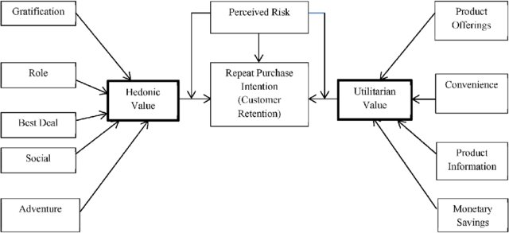
Case Study:
E-retail factors for customer activation and retention: A case study from Indian e-commerce customers
Customer satisfaction has emerged as one of the most important factors that guarantee the success of online store; it has been posited as a key stimulant of purchase, repurchase intentions and customer loyalty. A comprehensive review of the literature, theories and models have been carried out to propose the models for customer activation and customer retention. Five major factors that contributed to the success of an e-commerce store have been identified as: service quality, system quality, information quality, trust and net benefit. The research furthermore investigated the factors that influence the online customers repeat purchase intention. The combination of both utilitarian value and hedonistic values are needed to affect the repeat purchase intention (loyalty) positively. The data is collected from the Indian online shoppers. Results indicate the e-retail success factors, which are very much critical for customer satisfaction
Prediction:
We need to analyse the data to predict the E-retail factors for customer activation and retention

Slide 4

Libraries Imported for the Analysis
import pandas as pd
import numpy as np
import seaborn as sns
import matplotlib.pyplot as plt
import sklearn
from sklearn.preprocessing import LabelEncoder,OneHotEncoder
import warnings
warnings.filterwarnings('ignore')
import re
from sklearn.preprocessing import LabelEncoder
from scipy.stats import zscore
from statsmodels.stats.outliers_influence import variance_inflation_factor

Slide 5
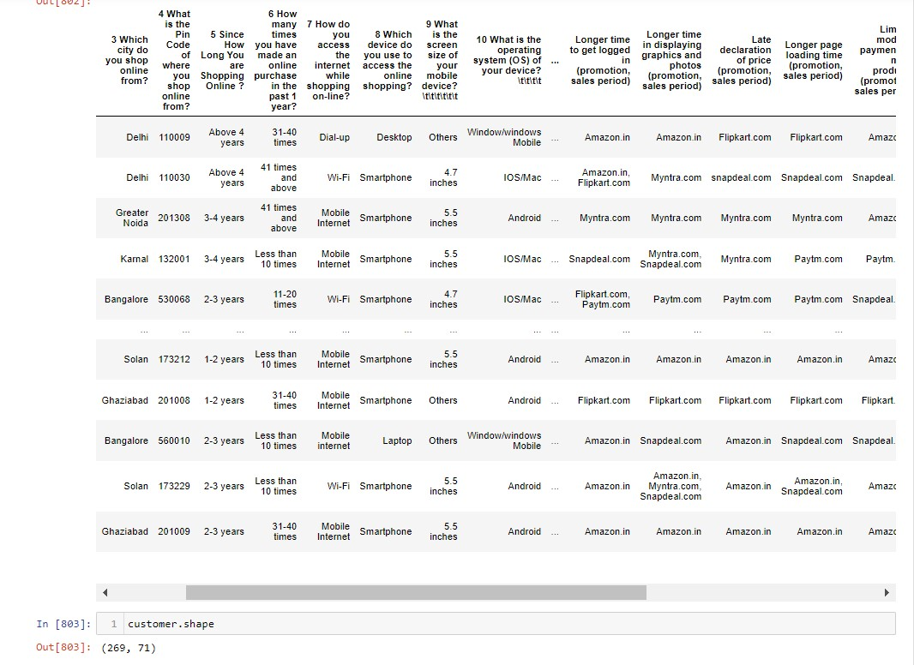
Getting insights about the dataset:
The data's are collected by questionnaire method. In which customer’s had responded to 71 questions by ratings and preferred online retailer based on service quality, system quality, information quality, trust and net benefit.
Loaded Customer Retention dataset and Created Data Frame
➢ We have total of 269 rows and 71 columns in customer retention
dataset.
➢ Out of which 70 columns data types are in object types (string value)
and column pincode is in integer type.
➢ As our dataset is categorical, We can consider the dataset as
supervised classification data
➢ We can consider the column 'Which of the Indian online retailer
would you recommend to a friend?' as our target column
➢ We don’t find any null values in our dataset

Slide 6
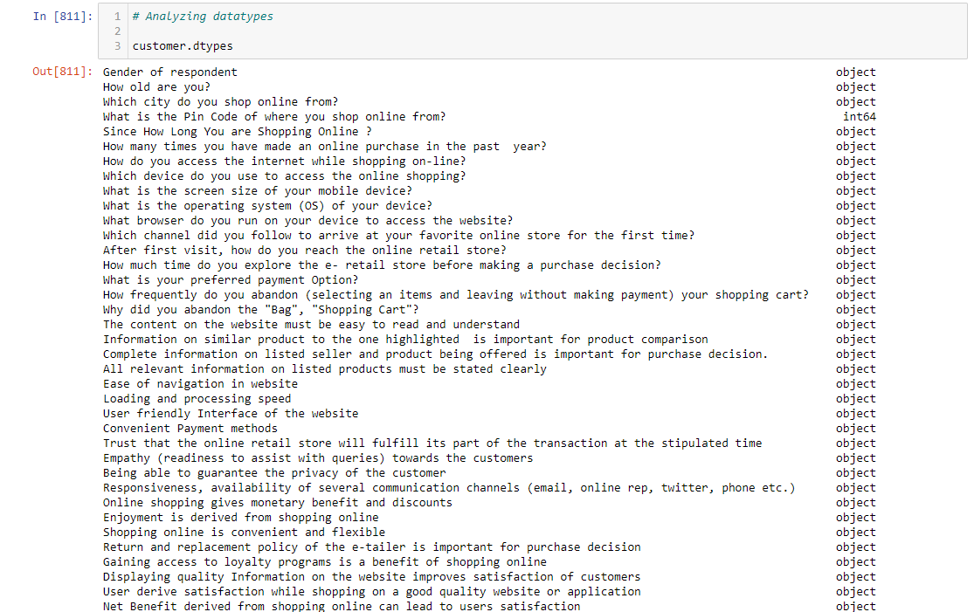
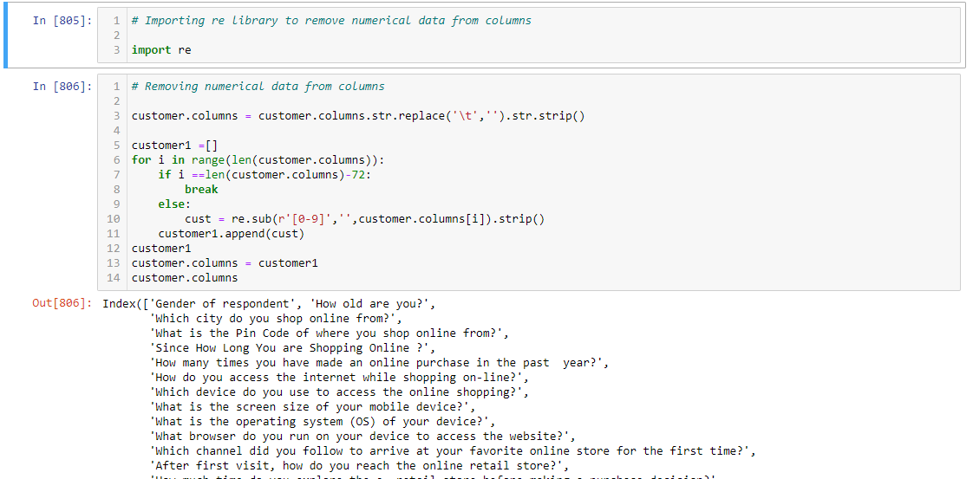
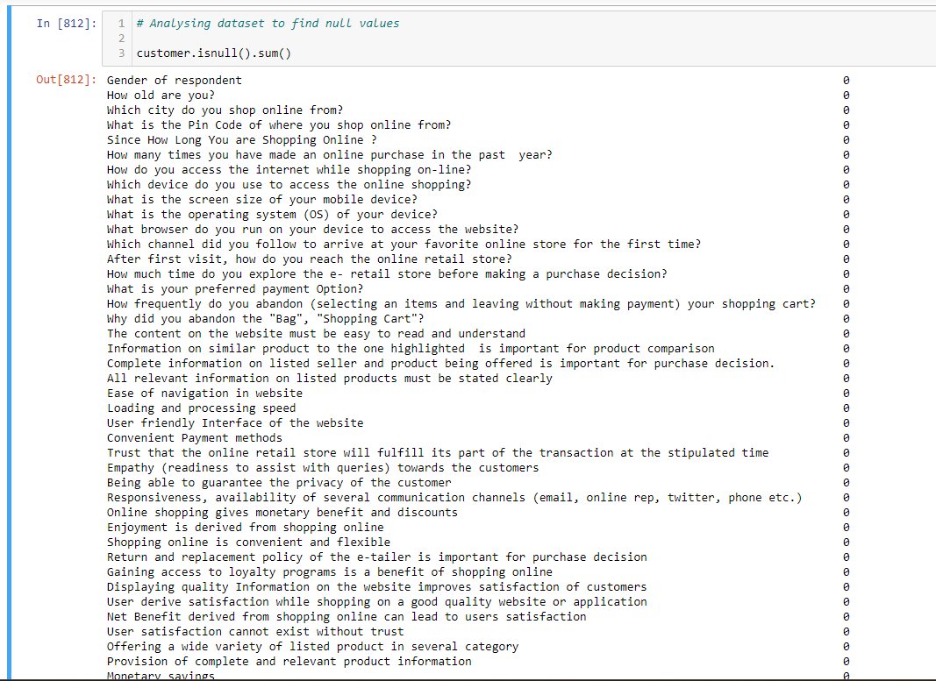
Getting insights about the dataset:
Steps to remove numerical data from columns
Analysing data types
Analysing dataset to find null values

Slide 7
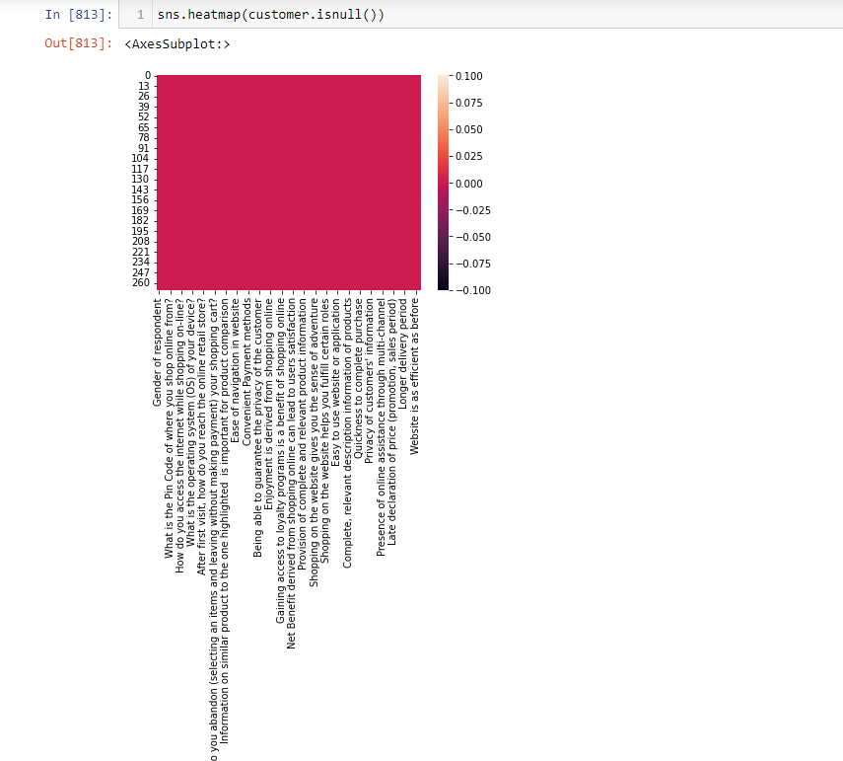
Getting insights about the dataset:
Visualizing data in heatmap to identify if there are any null values
We didn’t find any null values in our dataset

Slide 8
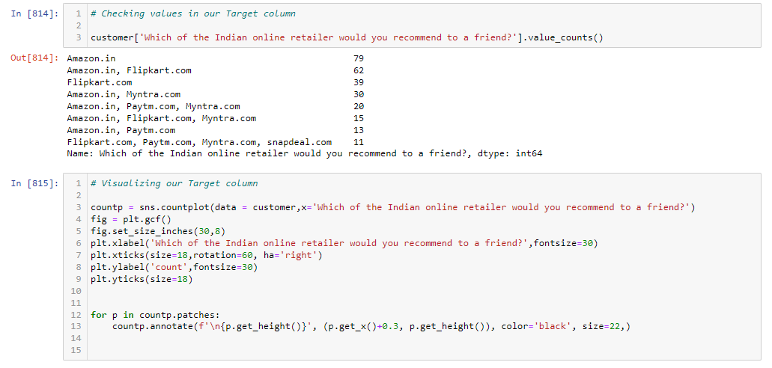
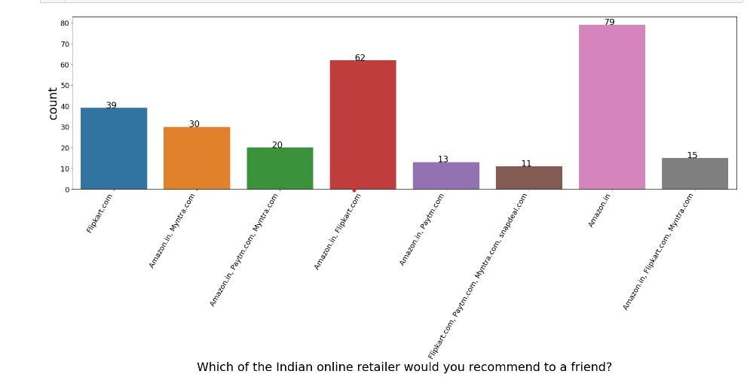
Data Visualization:
For visualizing the dataset count plot has been used to find out the count of the values
➢ Based on the customer response we can identify Amazon was the highly
recommended E Retailer among customers followed by Flipkart
➢ Female customers are high when compared to male and both of them
recommended Amazon and Flipkart as their online retailer
➢ 85% of the customers are from age category of 21-30 years, 31-40 years and
41-50 years
➢ Delhi tops the city list and Bulandshahr is in bottom of city list
➢ Customers who are shopping online for above 4 years uses amazon and Flipkart
➢ 42% of customer purchases less than 10 times a year
➢ 52% of customer uses smartphone to access the intern et for shopping on-line
➢ Google chrome was the highly used search engine
➢ 62% of the customers spend more than 11mins to explore the e- retail store
before making a purchase decision
➢ 55% customers use credit/debit cards for payment and 63% of customers
abandon frequently without making payment in that 49% customer finds better
alternative offer

Slide 9
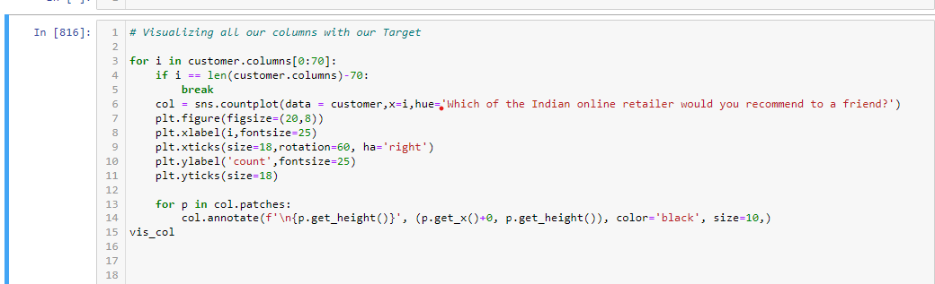
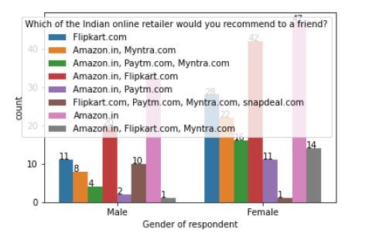
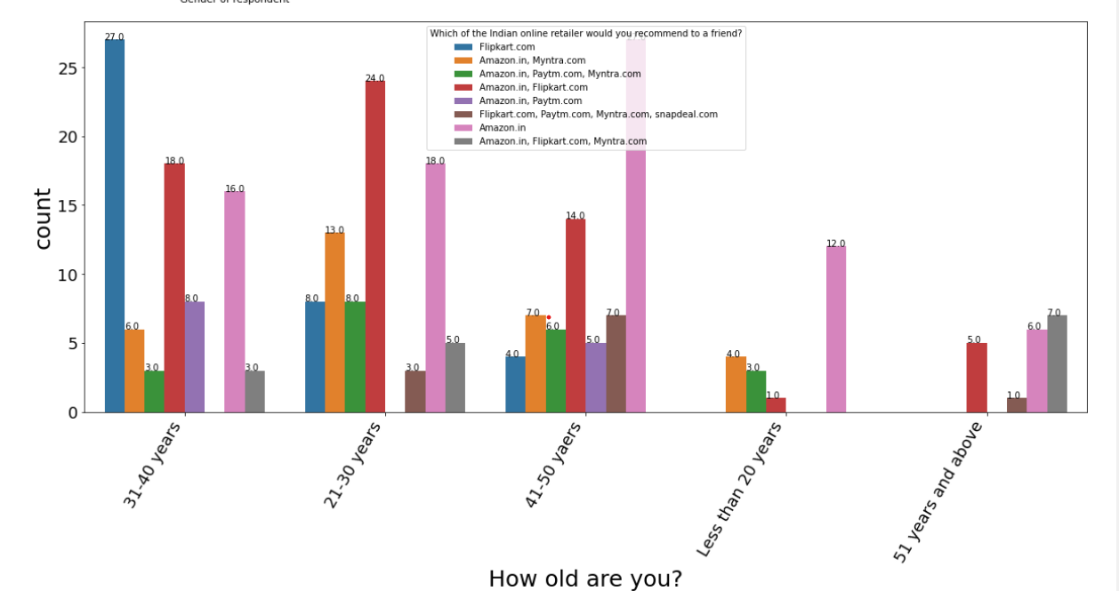
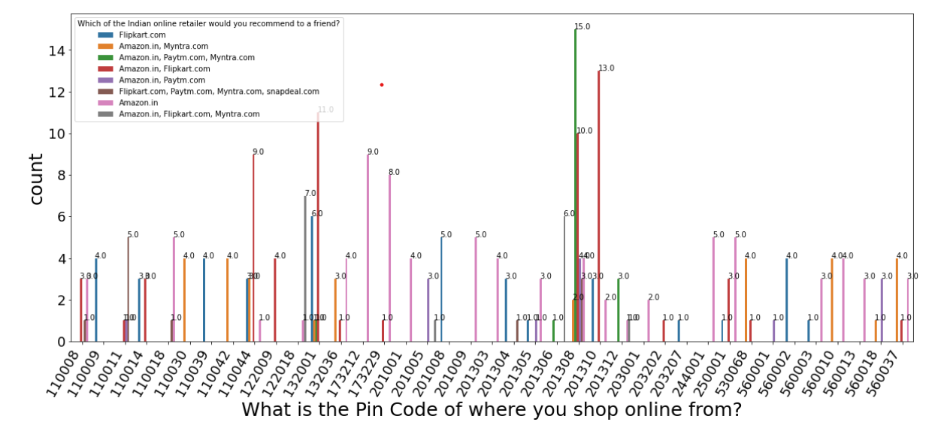
Data Visualization Steps
Following chart shows the graphical
Visualization of the columns
With count plot

Slide 10
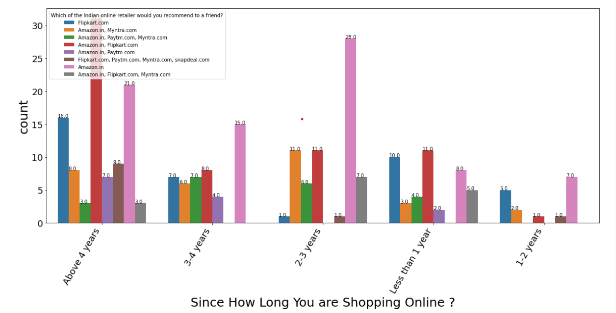
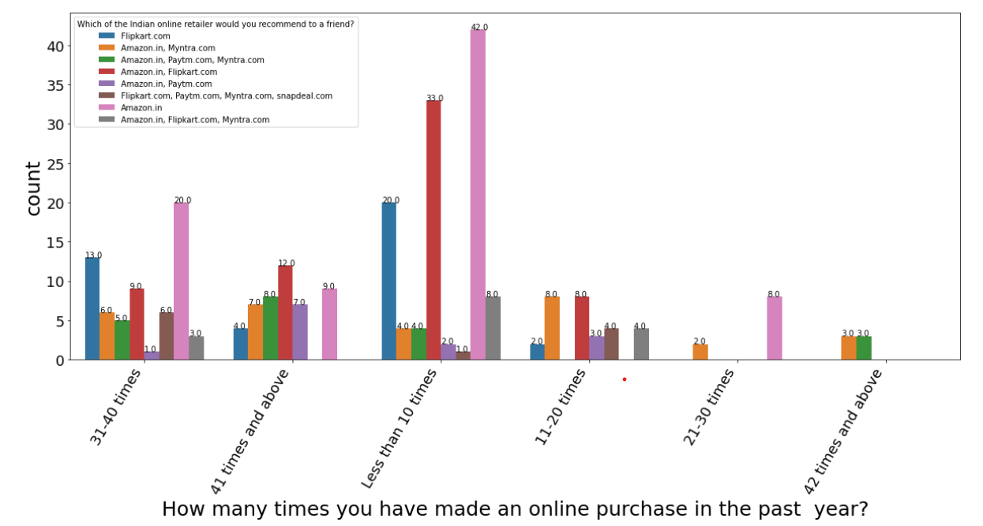
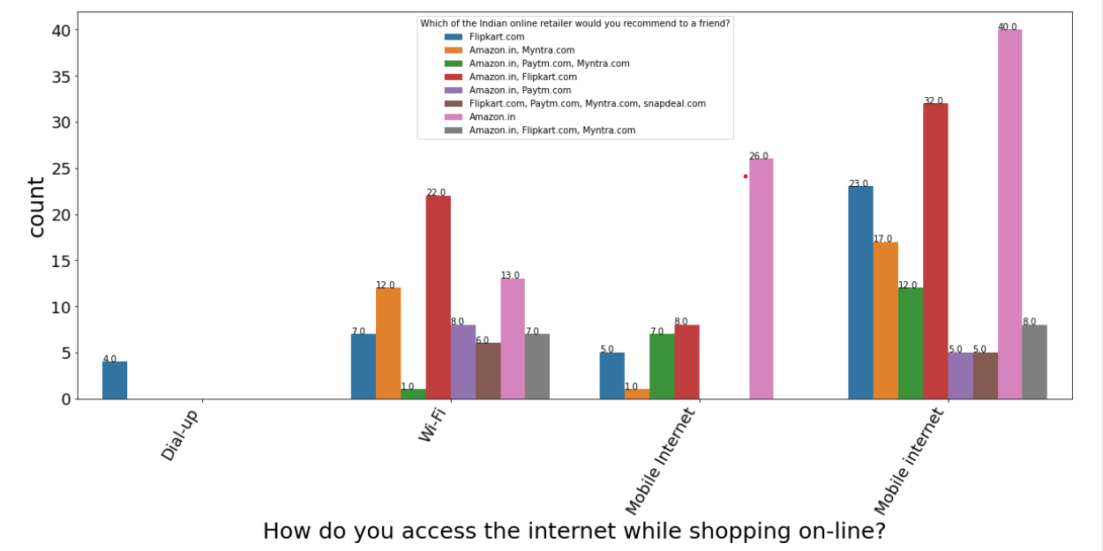
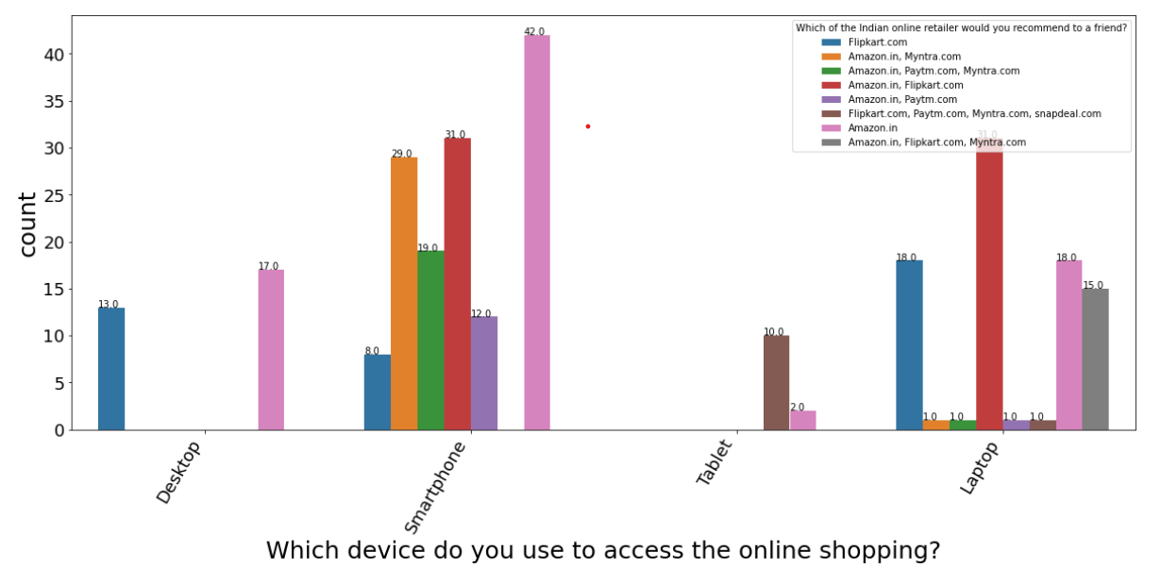
Data Visualization
Following chart shows the graphical
Visualization of the columns
With count plot

Slide 11
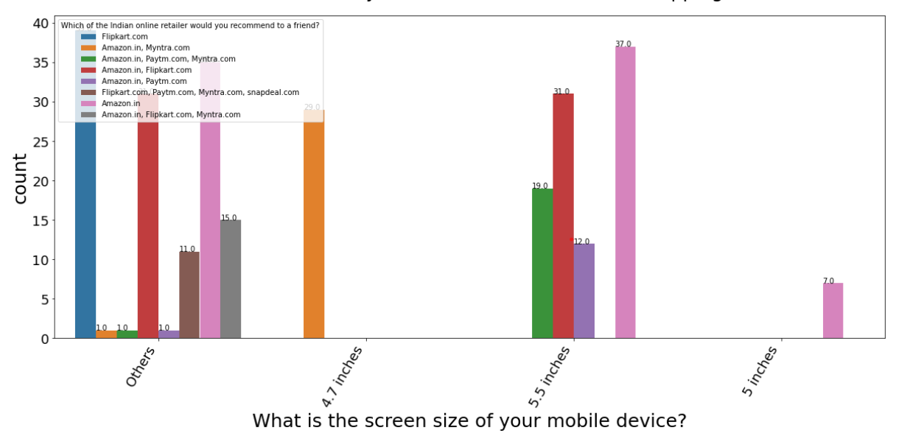
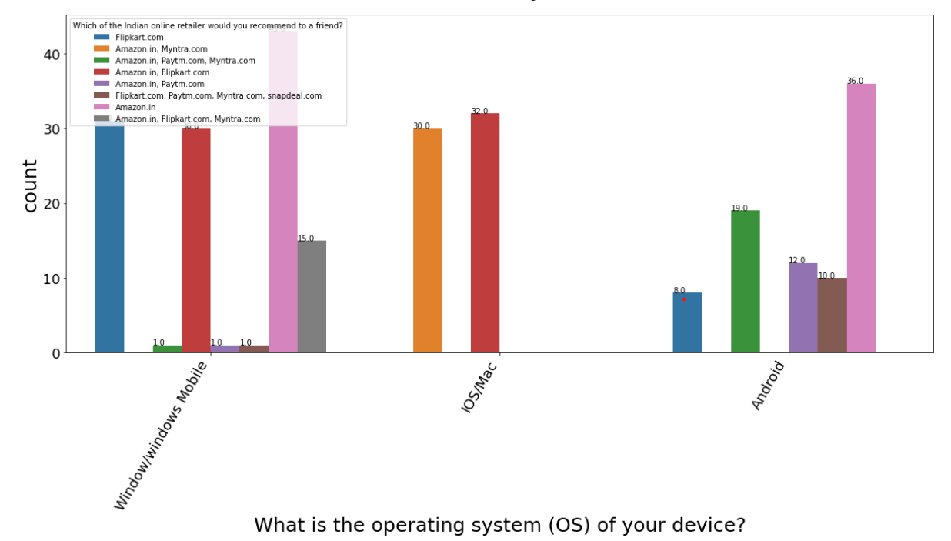
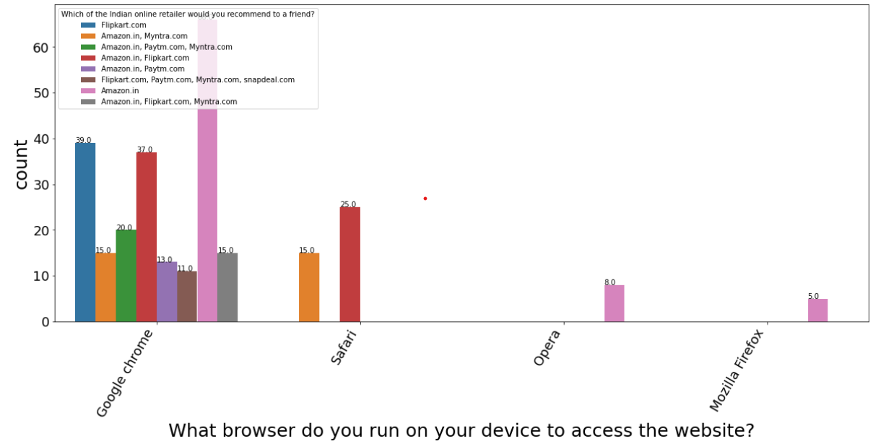
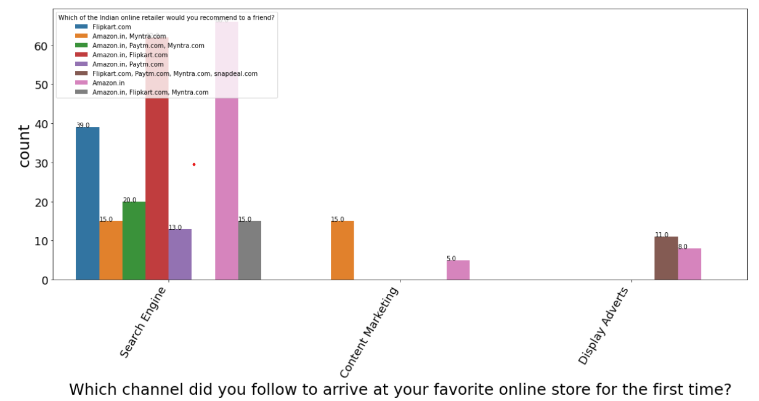
Data Visualization
Following chart shows the graphical
Visualization of the columns
With count plot

Slide 12
Data Visualization
Following chart shows the graphical
Visualization of the columns
With count plot

Slide 13
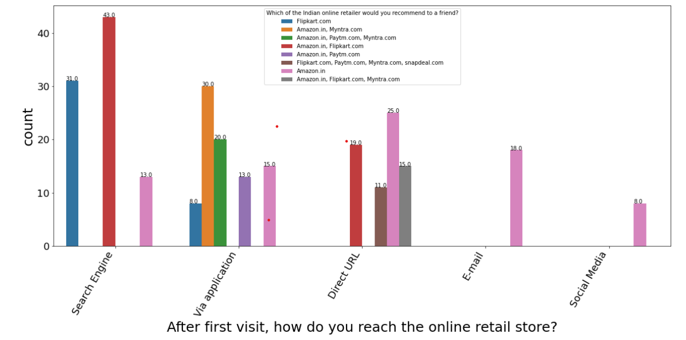
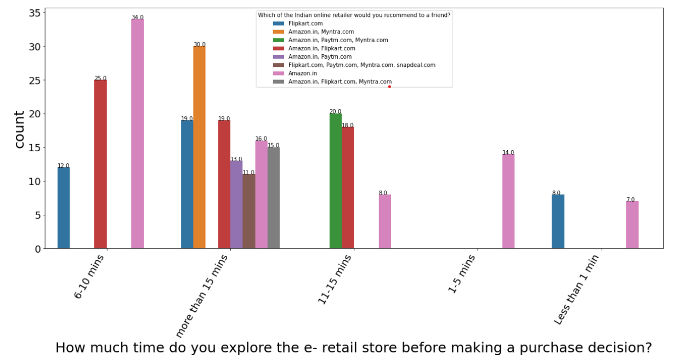
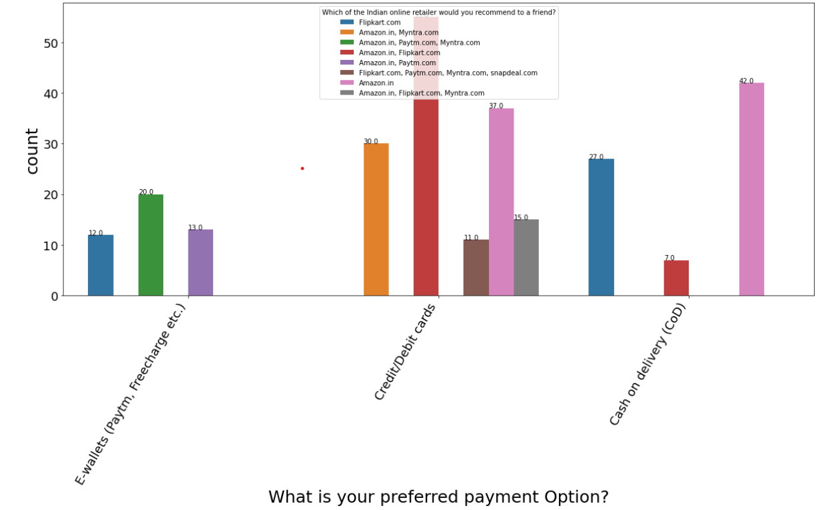
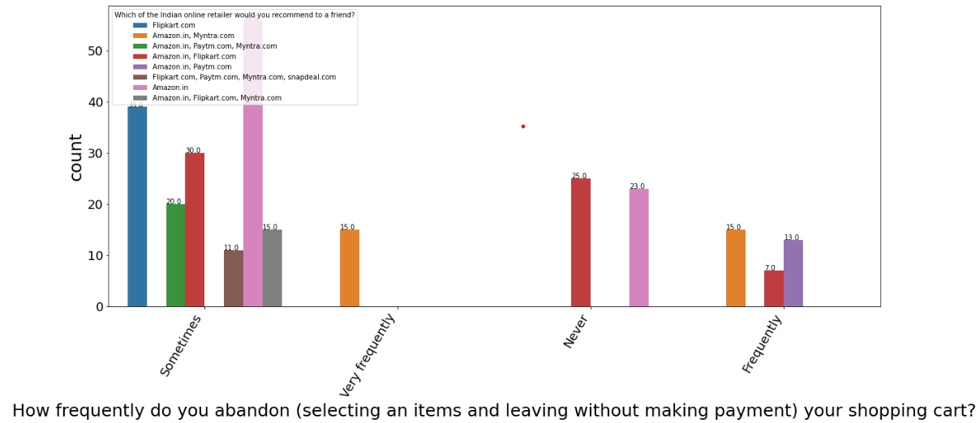
Data Visualization
Following chart shows the graphical
Visualization of the columns
With count plot

Slide 14
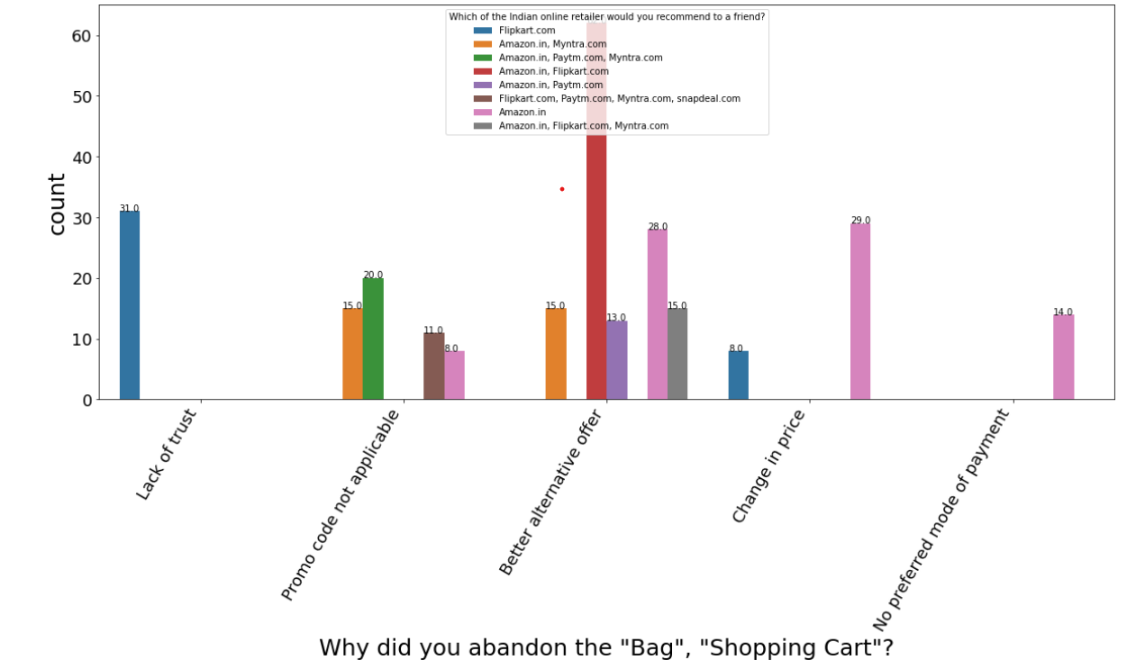
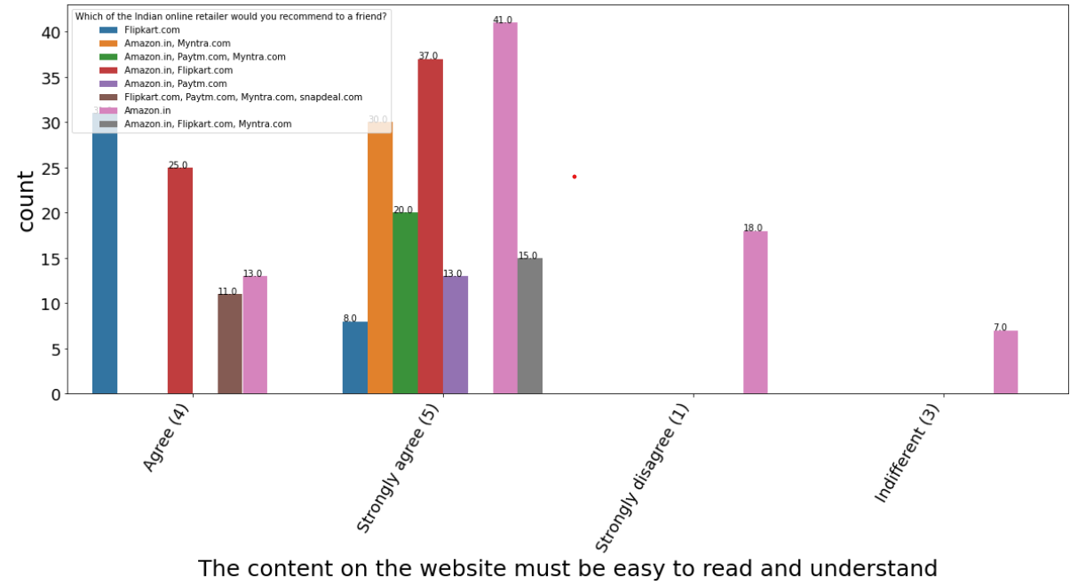
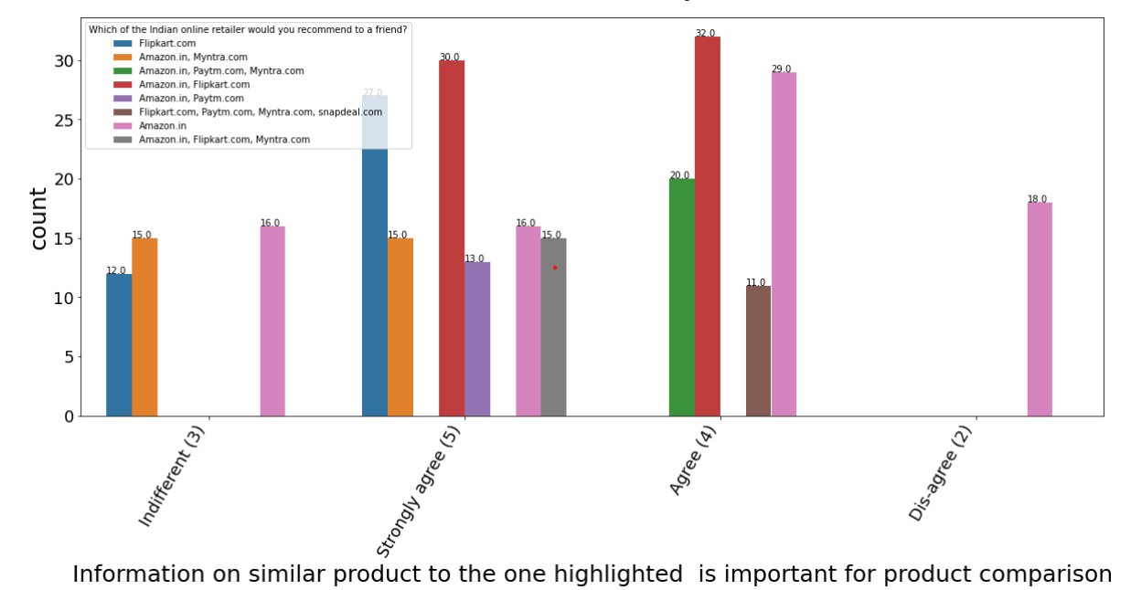
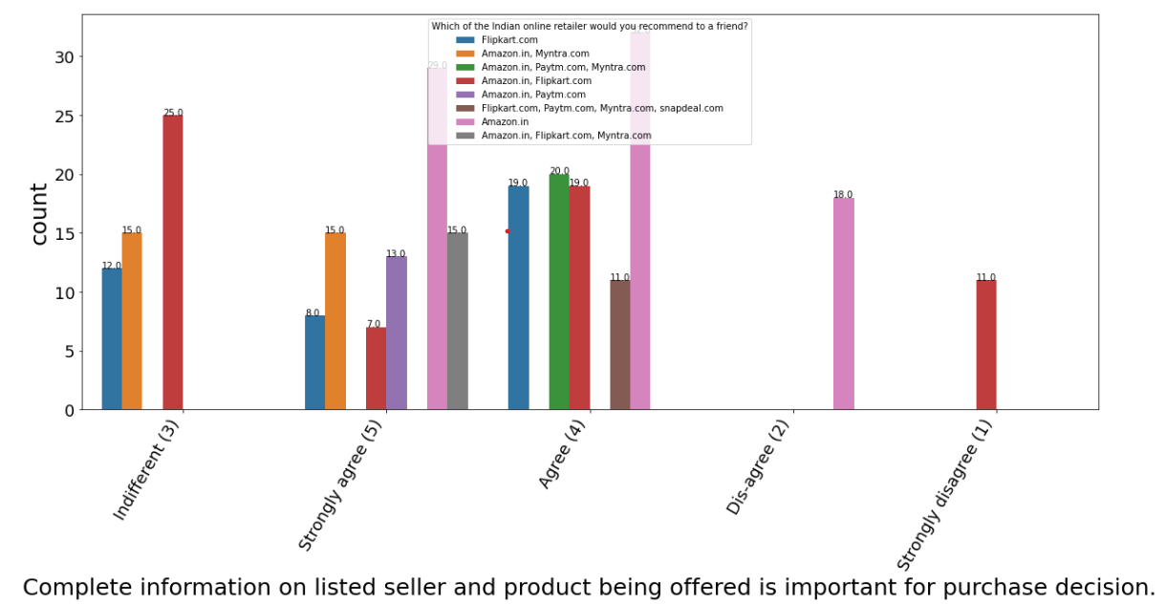
Data Visualization
Following chart shows the graphical
Visualization of the columns
With count plot

Slide 15
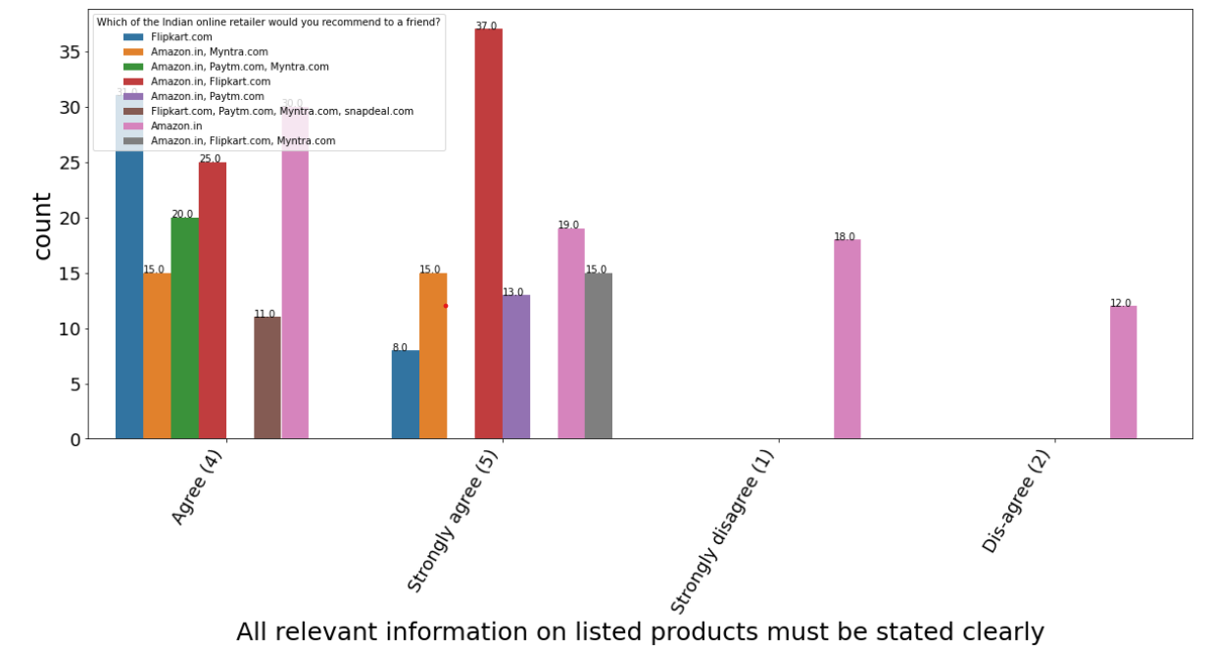
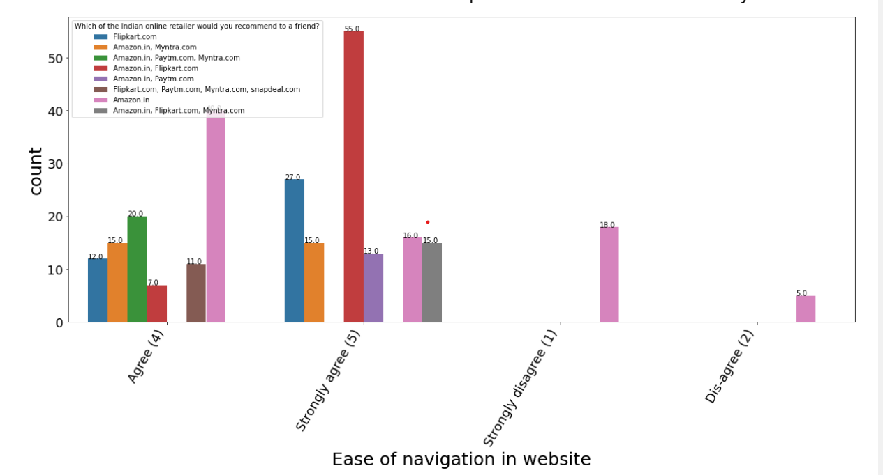
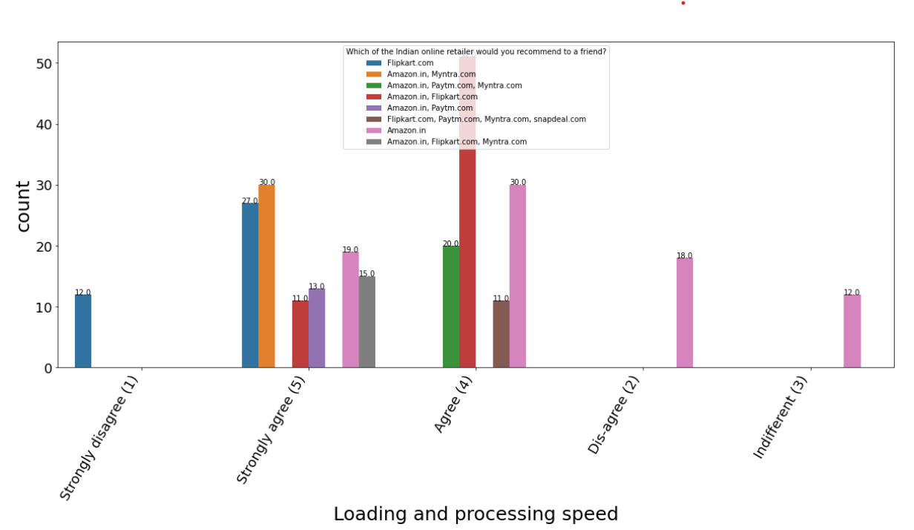
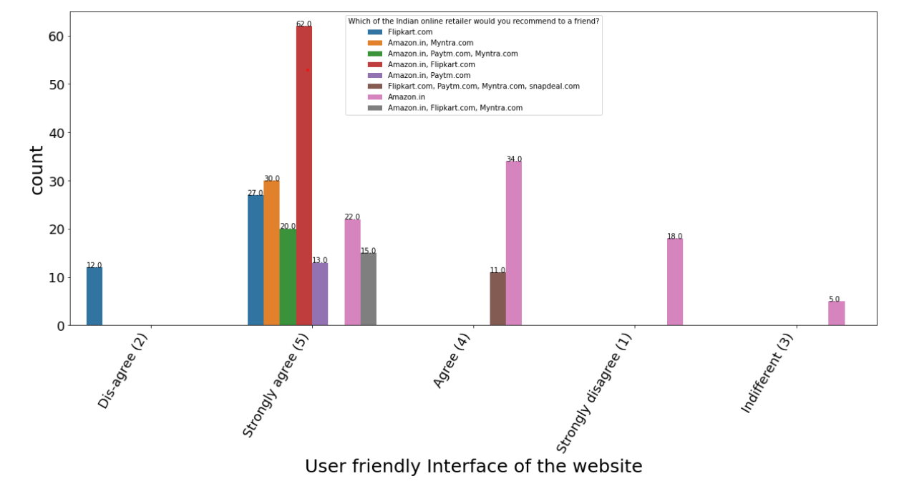
Data Visualization
Following chart shows the graphical
Visualization of the columns
With count plot

Slide 16
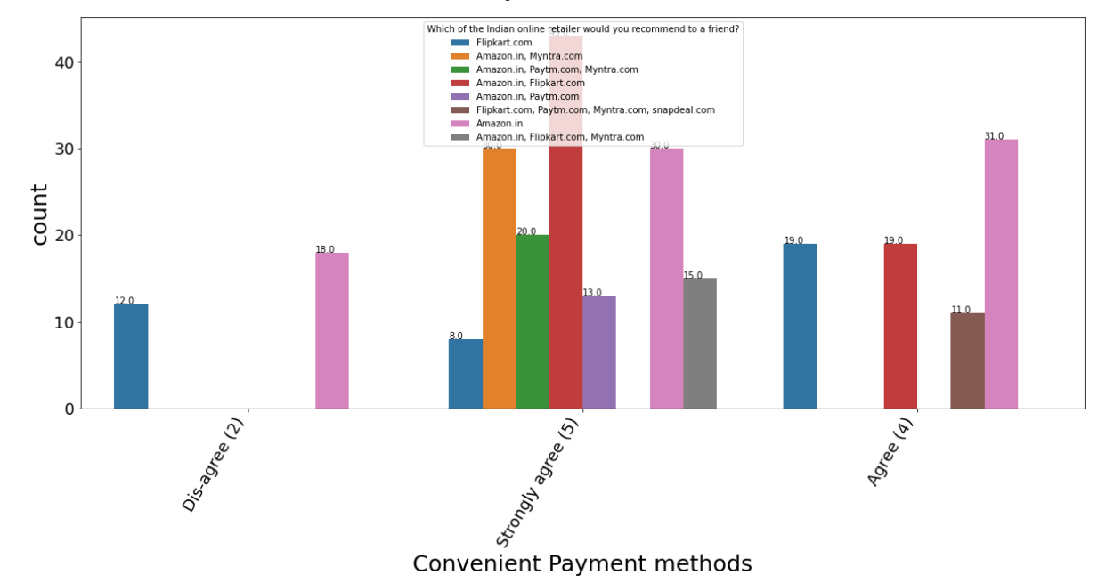
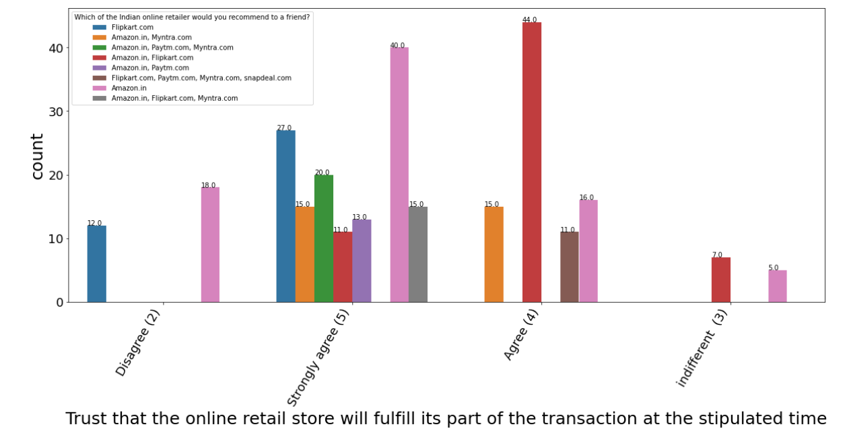
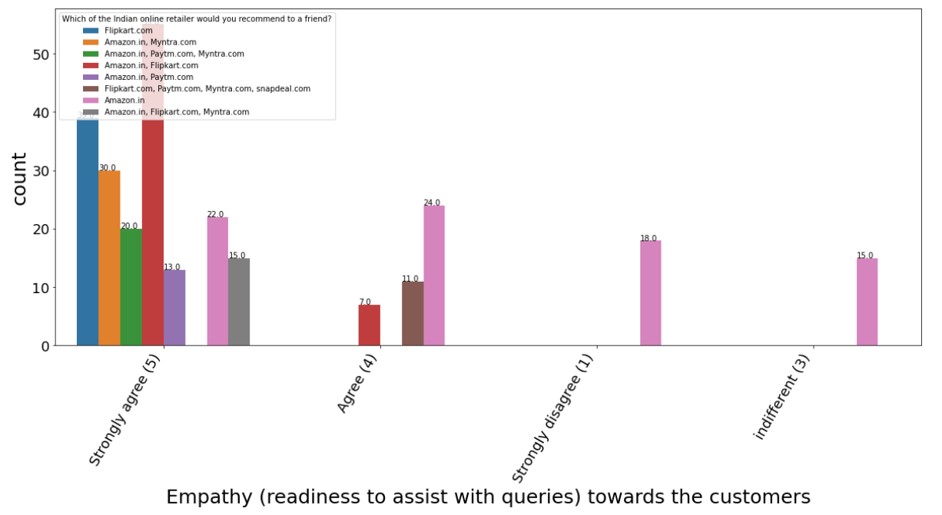
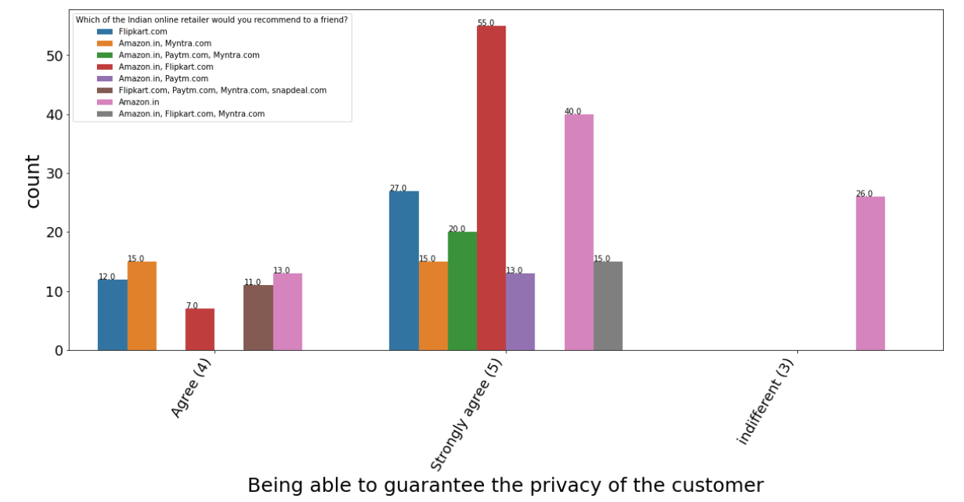
Data Visualization
Following chart shows the graphical
Visualization of the columns
With count plot

Slide 17
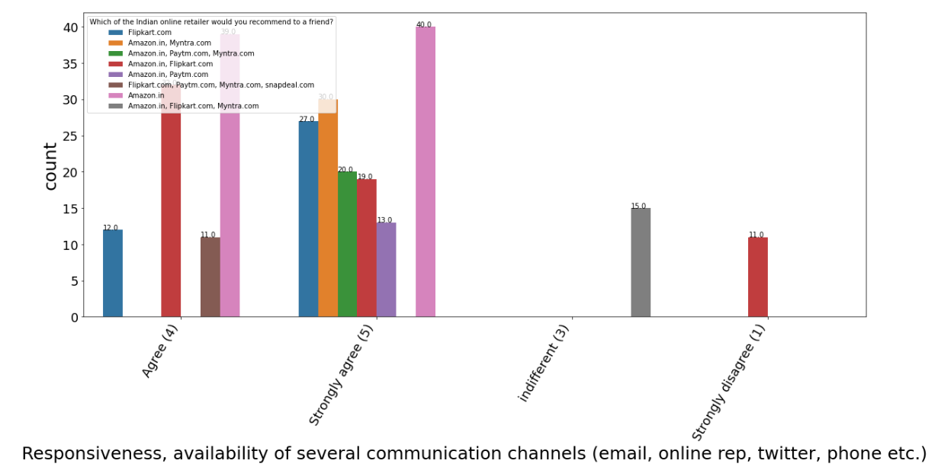
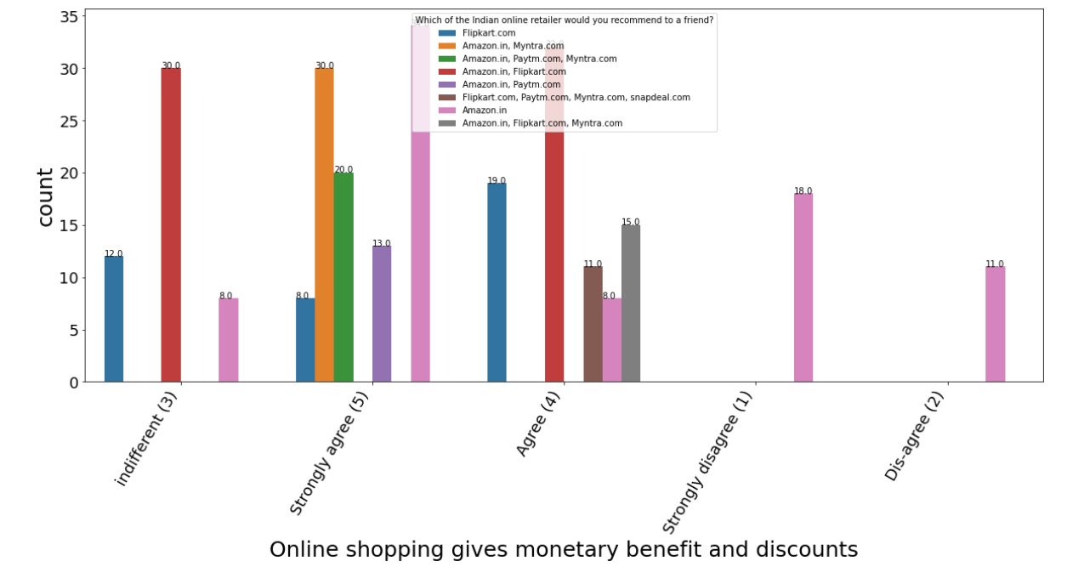
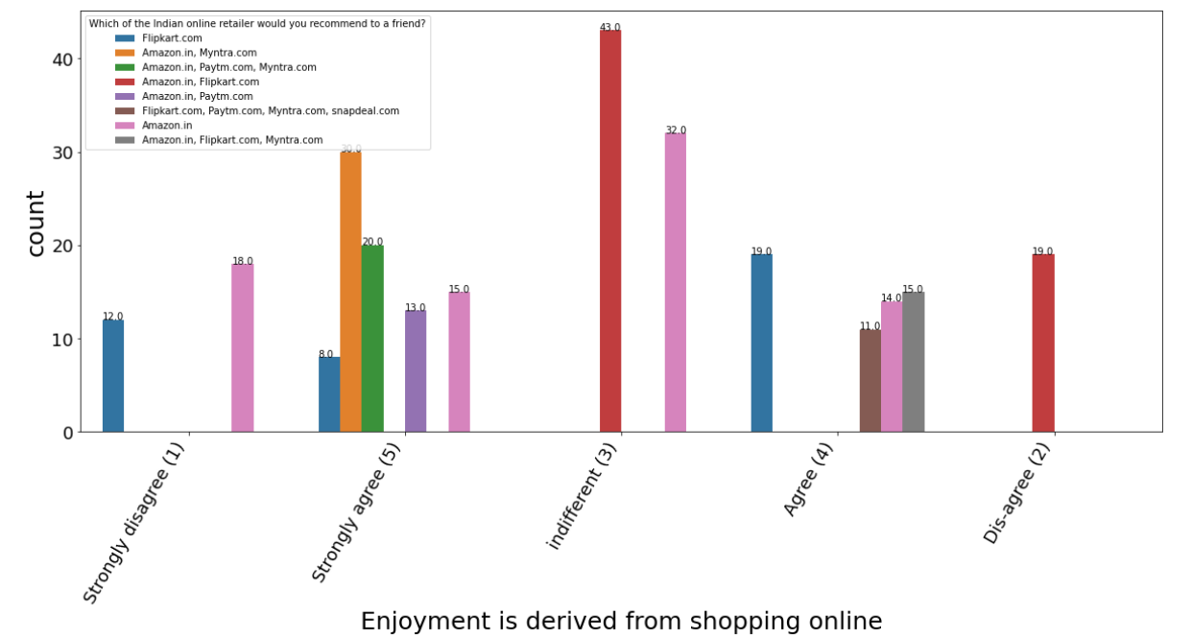
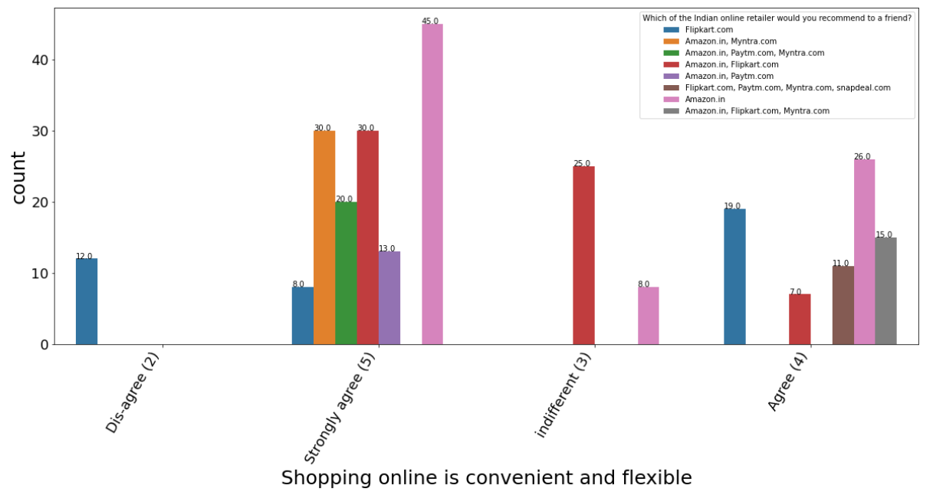
Data Visualization
Following chart shows the graphical
Visualization of the columns
With count plot

Slide 18
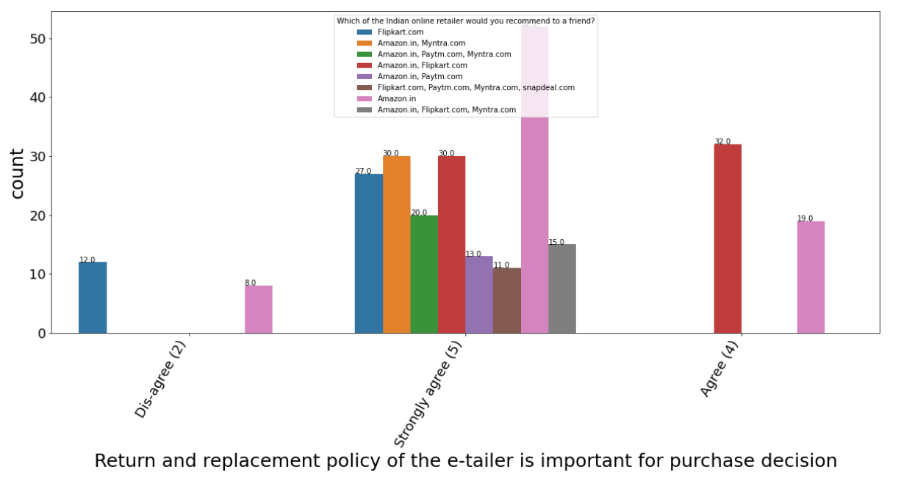
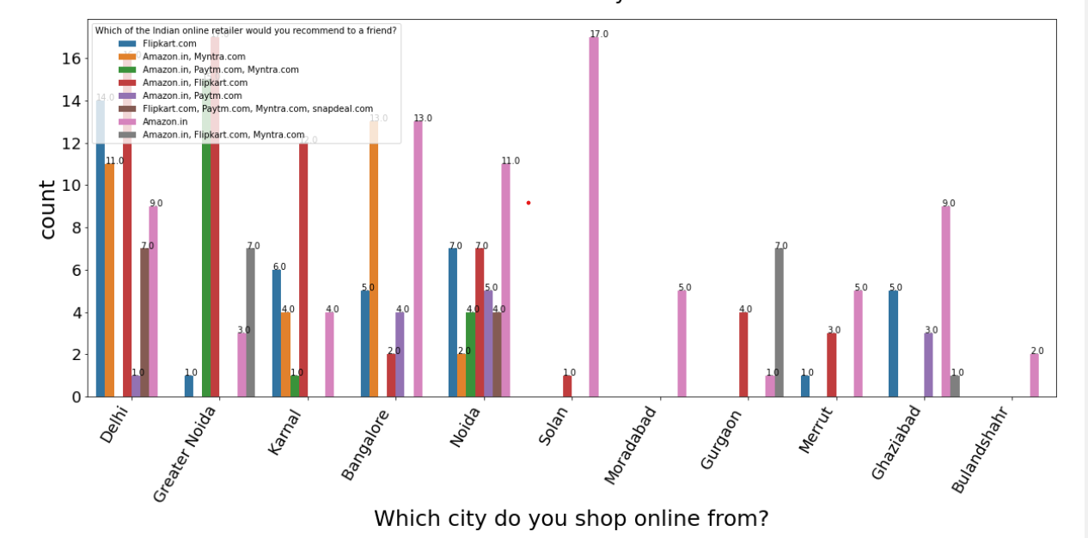
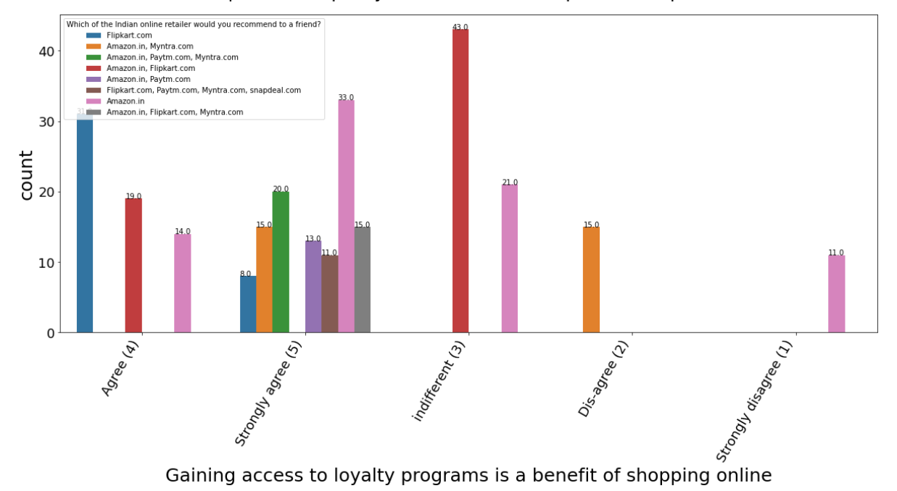
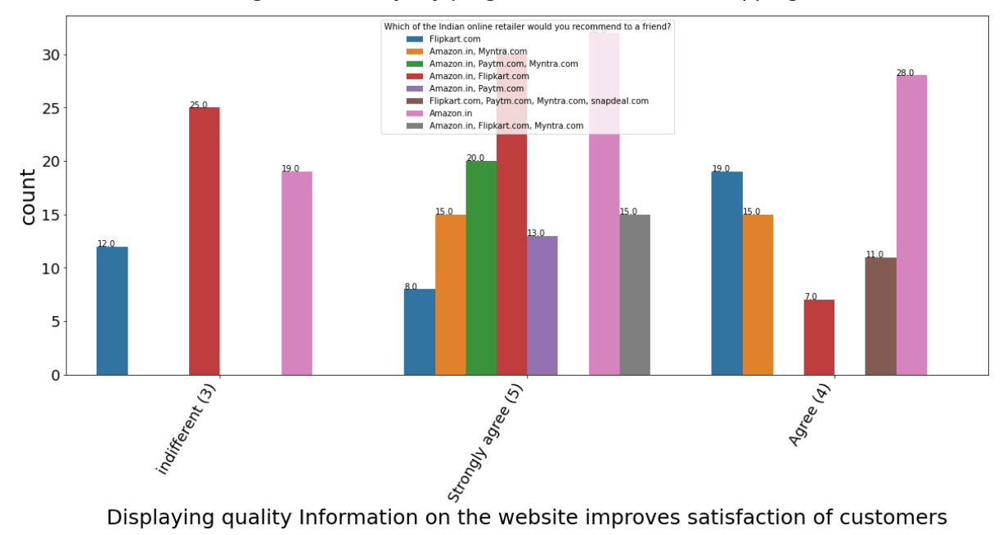
Data Visualization
Following chart shows the graphical
Visualization of the columns
With count plot

Slide 19
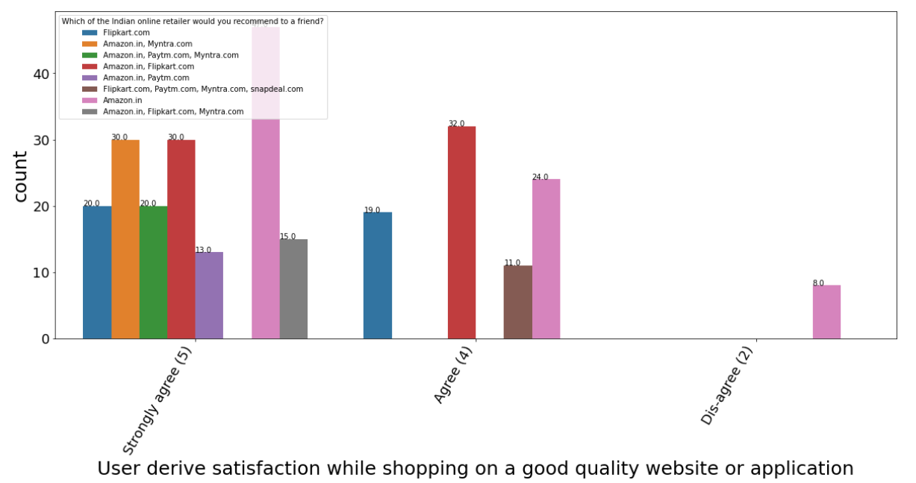
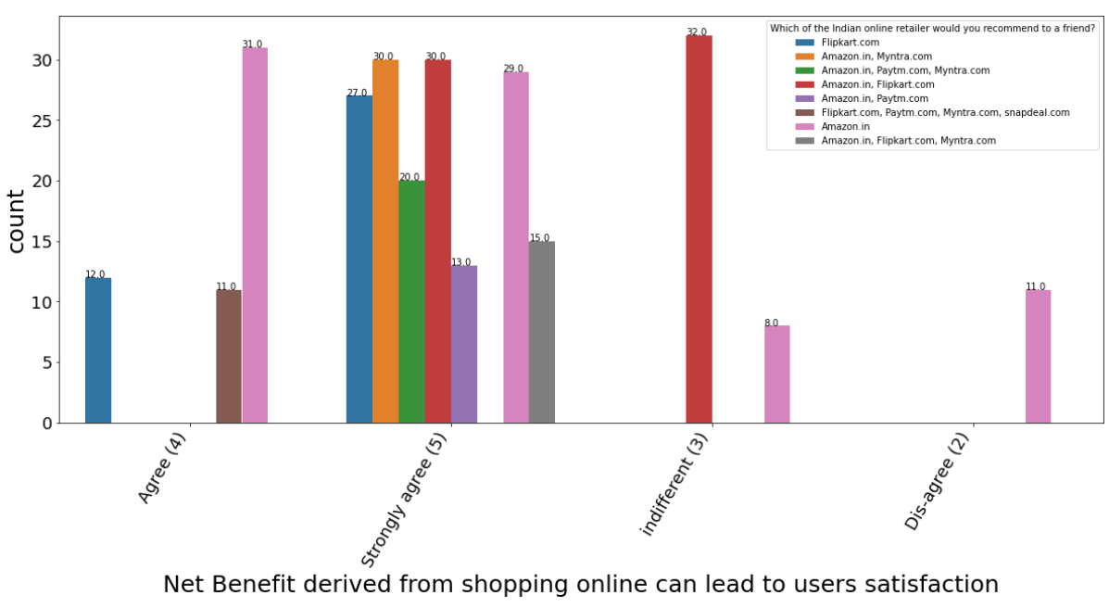
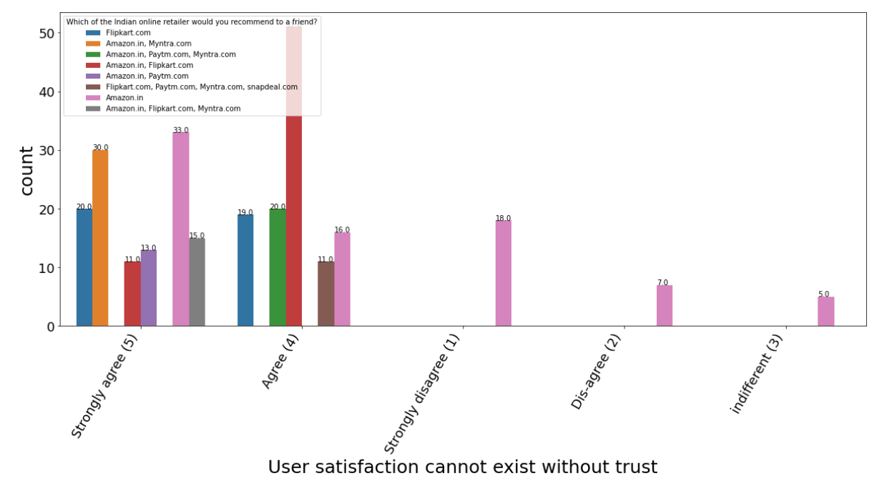
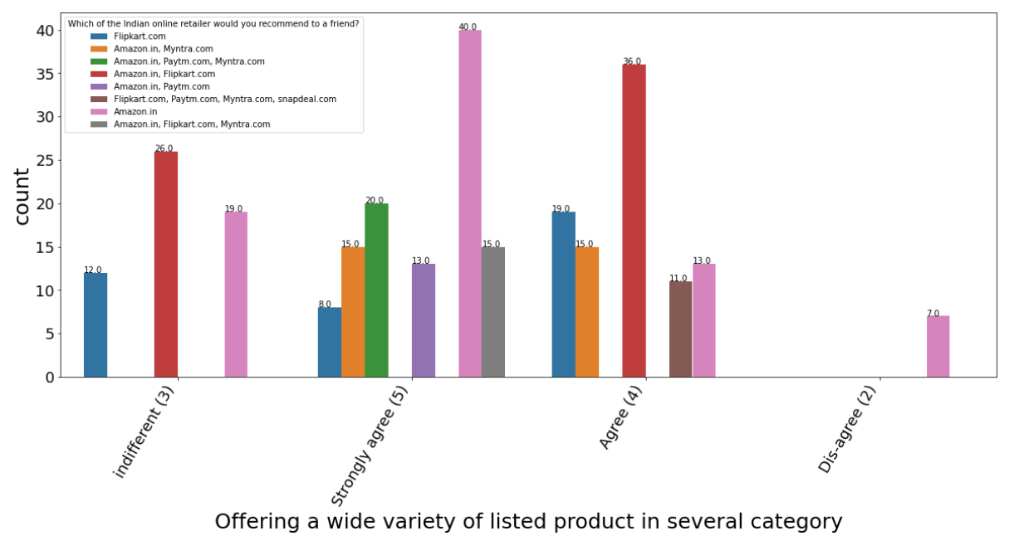
Data Visualization
Following chart shows the graphical
Visualization of the columns
With count plot

Slide 20
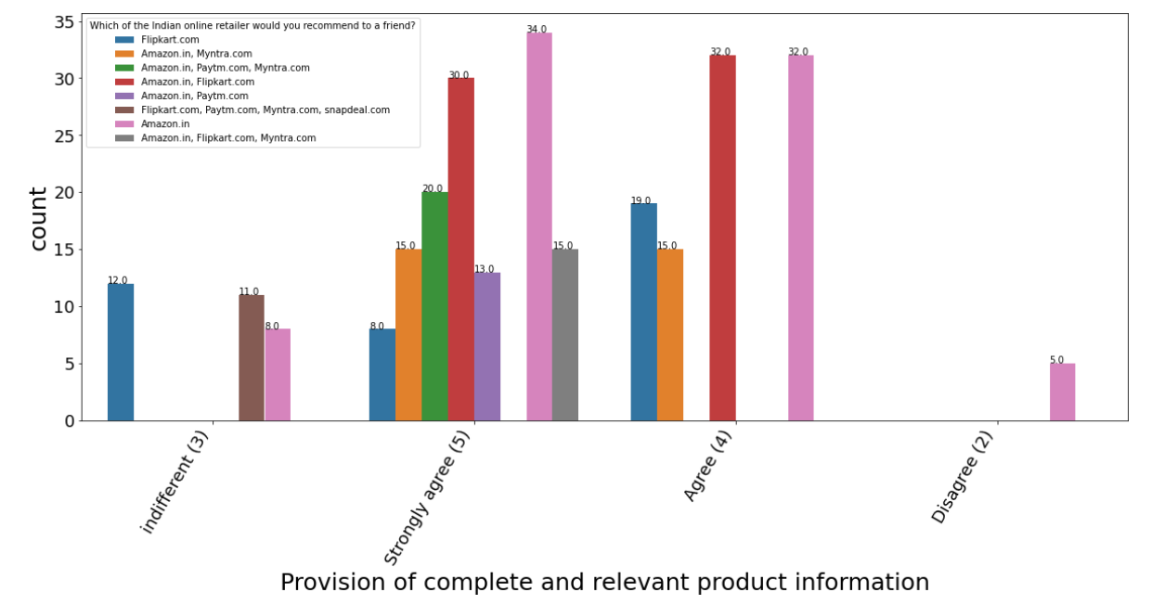
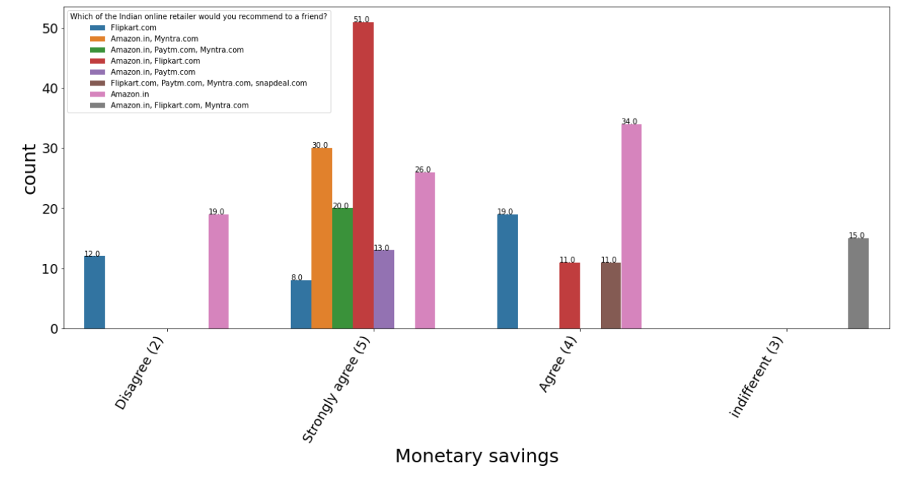


Data Visualization
Following chart shows the graphical
Visualization of the columns
With count plot

Slide 21




Data Visualization
Following chart shows the graphical
Visualization of the columns
With count plot

Slide 22




Data Visualization
Following chart shows the graphical
Visualization of the columns
With count plot

Slide 23




Data Visualization
Following chart shows the graphical
Visualization of the columns
With count plot

Slide 24




Data Visualization
Following chart shows the graphical
Visualization of the columns
With count plot

Slide 25




Data Visualization
Following chart shows the graphical
Visualization of the columns
With count plot

Slide 26




Data Visualization
Following chart shows the graphical
Visualization of the columns
With count plot

Slide 27


Data Visualization
Following chart shows the graphical
Visualization of the columns
With count plot

Slide 28

Feature Selection and
Feature Engineering
Describe
Applied describe method to check standard deviation, median, IQR percentile etc
➢ Mean is greater than median(50%) in most of the columns which
shows data is skewed on right side
➢ Pincode 75% to max value difference is high which means outliers
are present
➢ Count is same across all the columns stating no missing values

Slide 29

Feature Selection and
Feature Engineering
Encoding
Since dataset has a lot of string values. Encoding has been applied to convert the string data to
numerical

Slide 30


Feature Selection and
Feature Engineering
Correlation
In feature selection used correlation method to identify the positive and negative correlated values
Below are Negative correlated
➢ Enjoyment is derived from shopping online
➢ Gaining access to loyalty programs is a benefit of
shopping online
Below are Positive correlated
➢ Presence of online assistance through multi-
Channel
➢ Easy to use website or application
➢ Reliability of the website or application
➢ Complete, relevant description information of
products

Slide 31

Feature Selection and
Feature Engineering
Correlation
Visualizing correlation by heatmap

Slide 32

Feature Selection and Feature Engineering
Correlation
Visualizing correlation by bar plot

Slide 33


Feature Selection and
Engineering
Skew
Applied skew method to check the range of skewness
➢ Keeping +/- 0.5 as the range for skewness, there
are more number of columns which does
not lie within the range
Since data are categorial not applying transformation methods

Slide 34

Feature Selection and
Engineering
Detecting Outliers
Checking Outliers for pincode since the original data type is integer
Visualizing in box plot for column “What is the Pin Code of where you shop online from?”

Slide 35


Feature Selection and
Engineering
Z Score
Z Score Method to detect and remove Outliers
➢ After applying Zscore, data loss percentage is
7.4%
➢ Our data is becoming biased as it is not
considering the case of pincode which is the
only column with integer value, moreover our
dataset is categorical, we will not remove any
outliers and consider the original data

Slide 36

Feature Selection and
Engineering
Variance Inflation Factor
Variance Inflation Factor is used for Data cleansing, Feature Engineering.
➢ Our dataset is Multicolinearity which means
multiple input factor which is affecting the Y
Output
➢ Using this method we found most of the columns
VIF factor are infinity
Since our dataset is categorical we cannot remove columns based on VIF value.

Slide 37


Feature Selection and
Engineering
Variance Inflation Factor
Variance Inflation Factor is used for Data cleansing, Feature Engineering.

Slide 38


Final Analysis
We can use the original data for Machine learning Model, as our dataset is categorical and removing outliers and applying methods for skewness is not appropriate to predicting or developing the model
For Machine learning Model we should use logistic regression, since our dataset is classification.
Conclusion
Majority of the customers agree to the factor that the websites must be easy to read and understand, similar product to the one highlighted is important for product comparison, information on listed seller and product is important for purchase decision.
When purchasing a product from online, customers are majorly looking into these factors Ease of navigation in website, Loading and processing speed, Convenient Payment methods, Being able to guarantee the privacy of the customer, Return and replacement policy.
87% of customers trust that the online retail store will fulfil its part of the transaction at the stipulated time and 97% of customers satisfaction improves when displaying quality Information on the website, while 80% User derive satisfaction when shopping on a good quality website or application.

Slide 39

Thank You
Online Shopping
Checkout

